Slide 1



Licensing & Ordering Guide

Slide 2
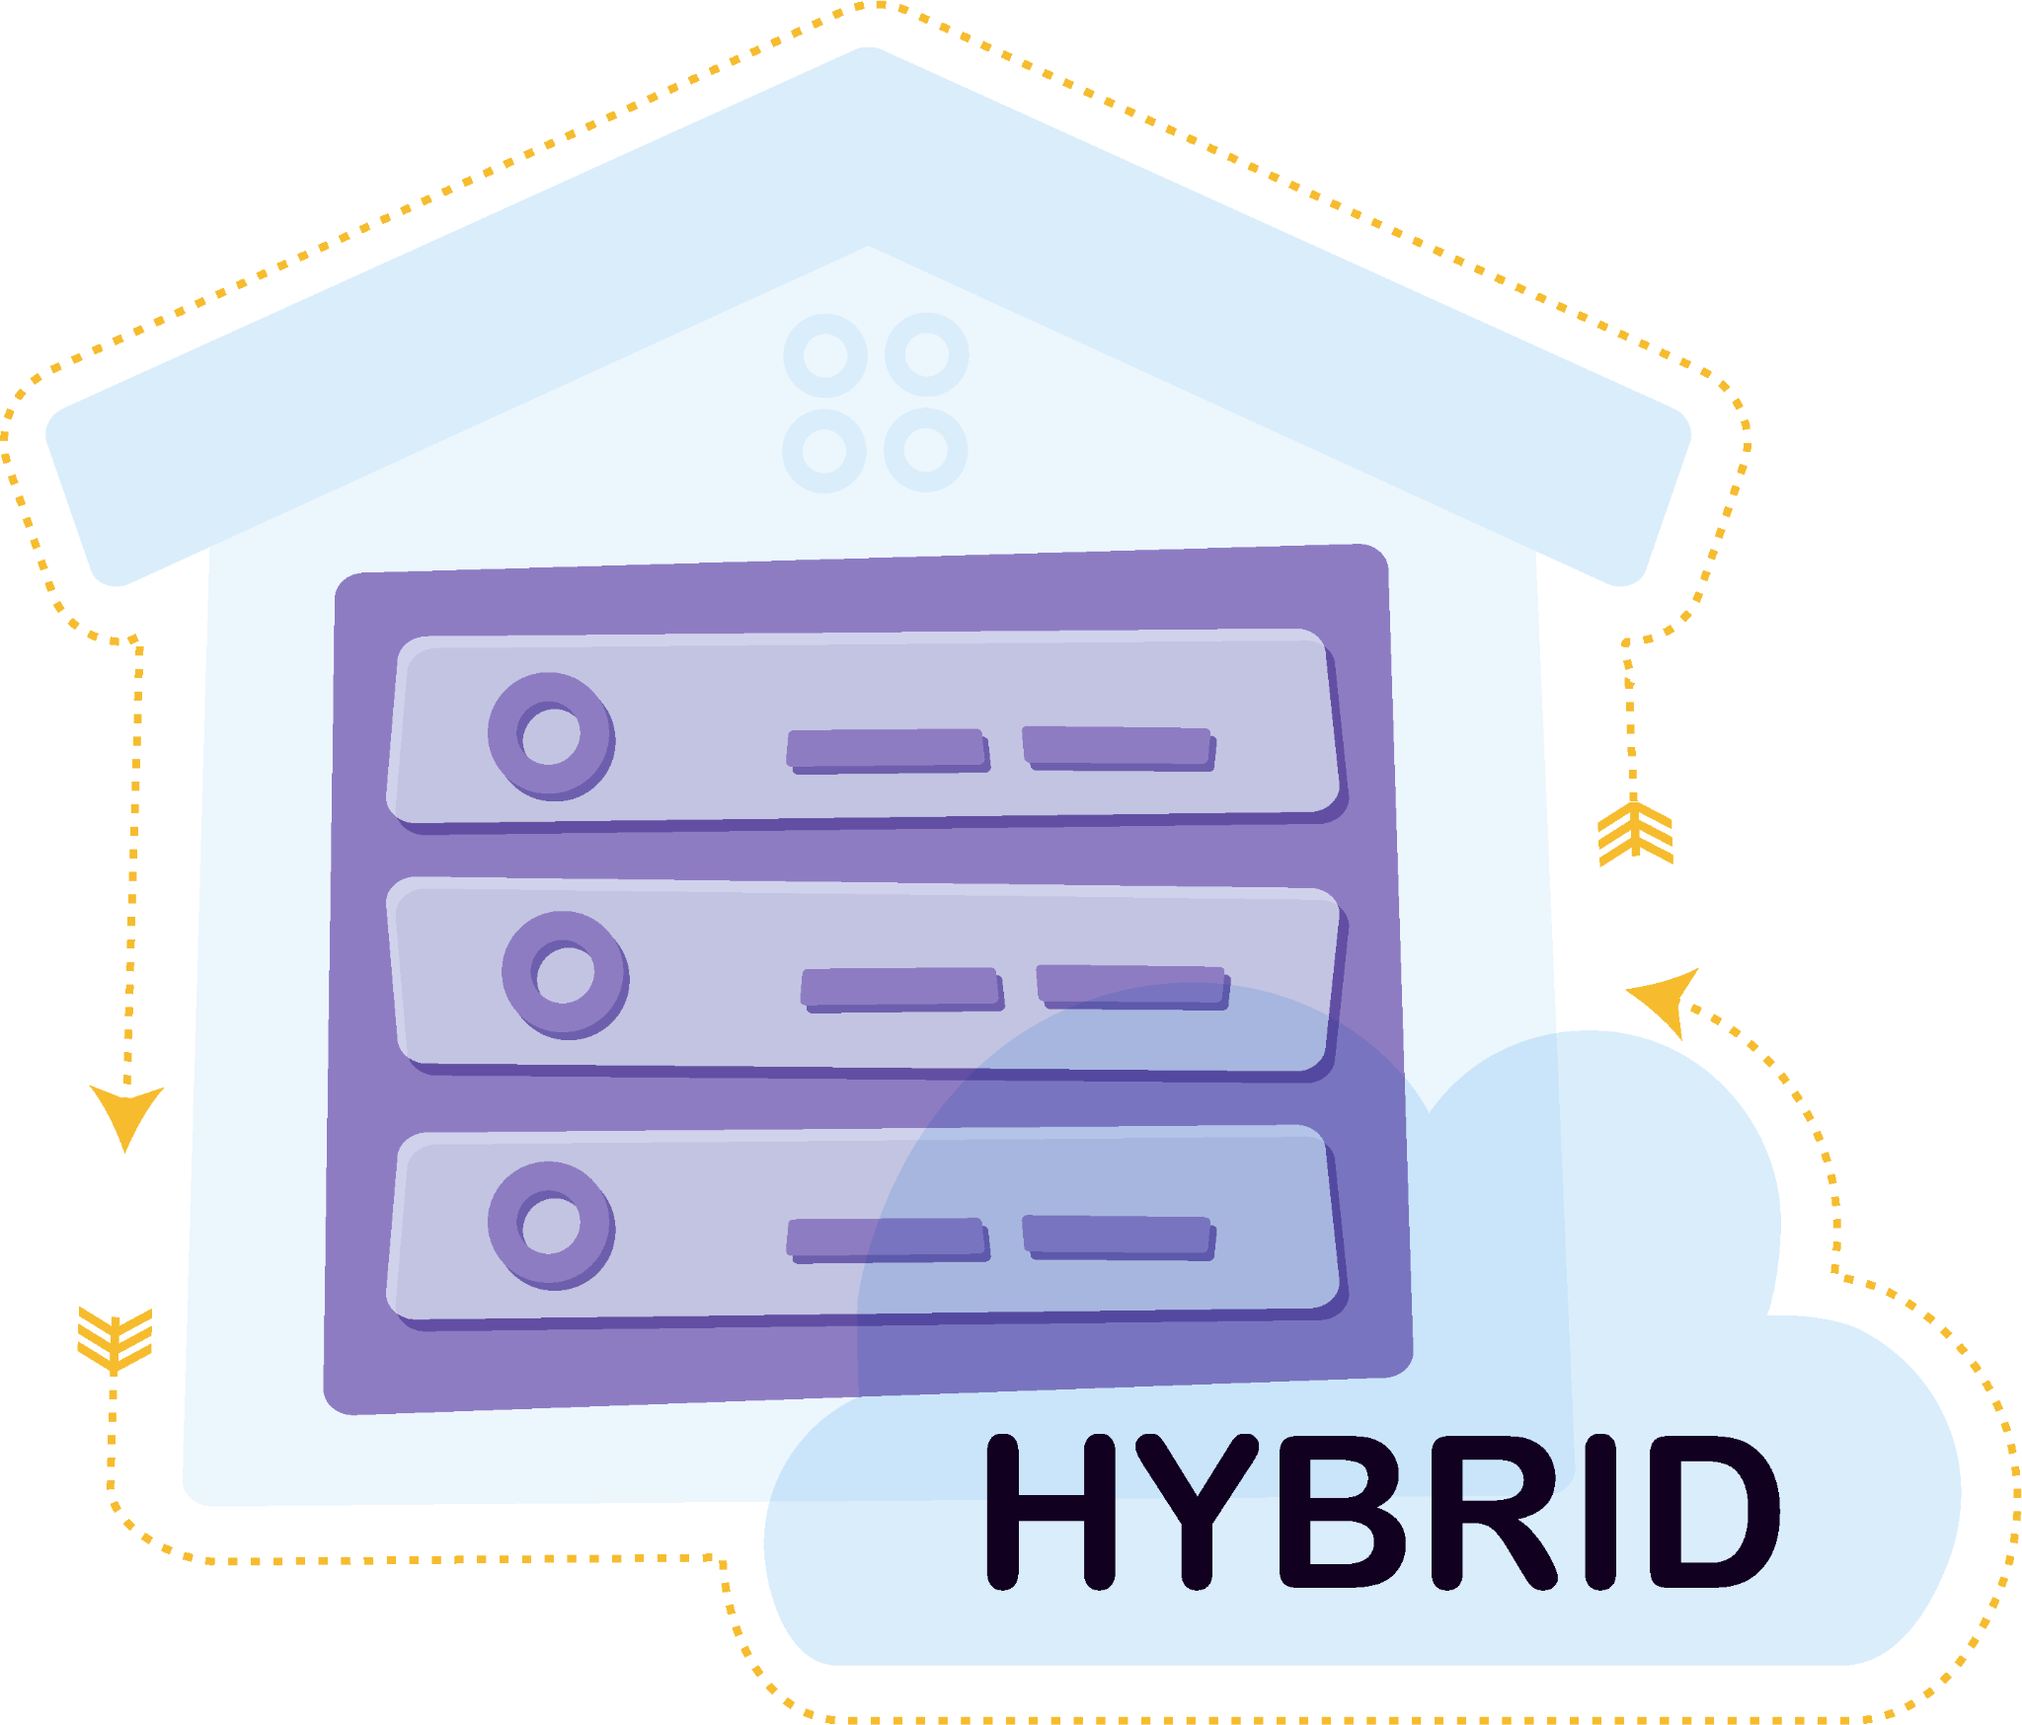
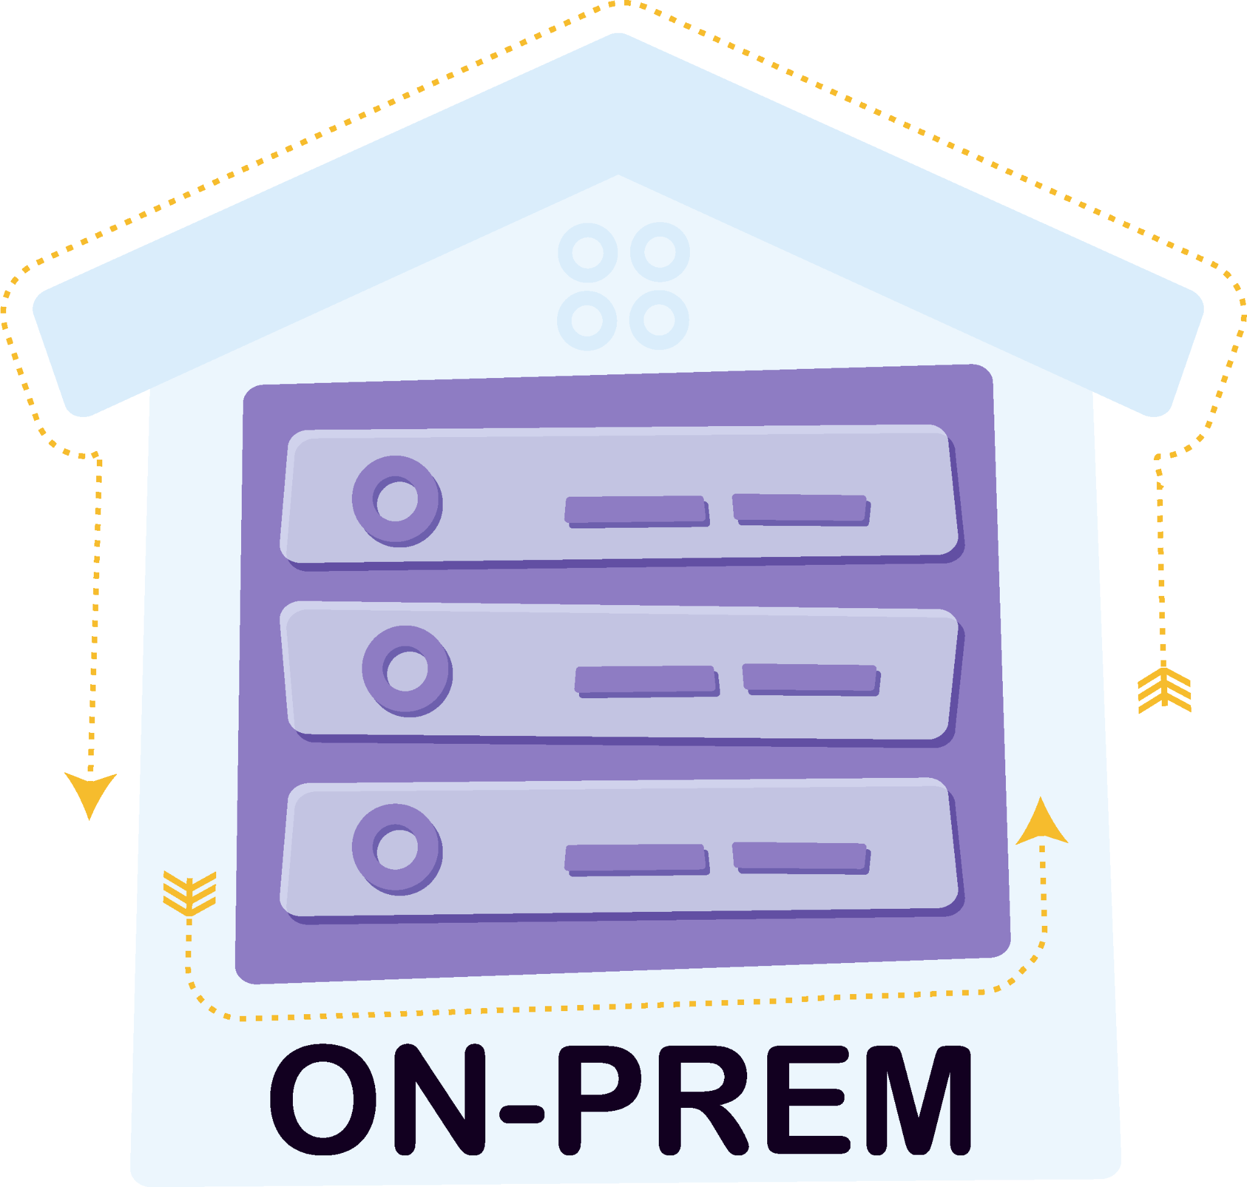






A FAMILY OF WORKFLOW AUTOMATION SOLUTIONS
On-Premise and Hybrid
Installations SUPPORTED!
Notes:
Good [morning/afternoon], everyone! Today, I am excited to introduce you to a family of task automation solutions that can transform how your assistants work, empowering them to focus on strategic business initiatives - An assistant for your assistant.
Let's delve into how our on-premise, hybrid, and cloud solutions work together.
On-Premise Solutions:
Dispatcher Phoenix and Dispatcher Phoenix SCANTRIP
our tried-and-true on-premise offerings, Dispatcher Phoenix. This robust solution has been a staple in many organizations, and we are thrilled to announce that both on-premise and hybrid installations are/will be available!
and Moving to our true cloud offerings: Dispatcher Stratus and ScanTrip Cloud

Slide 3
Differentiating KM with value-added solutions and moving into services-based offerings!
Dispatcher ScanTrip Cloud
Dispatcher Stratus Starter
Traditional workflow automation in the cloud
Core scan workflows integrated with KM MFPs
Dispatcher Stratus Business
Standard people-based workflows
Dispatcher Stratus Enterprise
Advanced people-based workflows with ECM automation capabilities
3
3
Notes:
Good [morning/afternoon], everyone! Today, I am excited to introduce you to a family of task automation solutions that can transform how your assistants work, empowering them to focus on strategic business initiatives - An assistant for your assistant.
Let's delve into how our on-premise, hybrid, and cloud solutions work together.
On-Premise Solutions:
Dispatcher Phoenix and Dispatcher Phoenix SCANTRIP
our tried-and-true on-premise offerings, Dispatcher Phoenix. This robust solution has been a staple in many organizations, and we are thrilled to announce that both on-premise and hybrid installations are/will be available!
and Moving to our true cloud offerings: Dispatcher Stratus and ScanTrip Cloud

Slide 4

SOLUTION VALUE
Driving digital transformation by uniting people, processes and automation.
Key Benefits:
  Platform for Bridging MFP to Cloud
  True Cloud Architecture
  Global Multi-Tenant Solution with Simplified Onboarding
  Cloud Intelligent Process Automation
  Zero Trust Security
  Flexible MFP Forms Management

Slide 5



FEATURE HIGHLIGHTS - CONTINUED
Tenant Management
Administrators can quickly set up and manage tenant accounts through the Tenant Management portal. This includes inviting Tenant Admins, updating tenancy information, and more.
Advanced Roles & Permissions
Ensure information security by assigning specific permissions to each user and controlling access to sensitive data and features.
License Management
Administrators can manage device licenses efficiently from a single interface, ensuring compliance and cost-effectiveness.
User Roles & Permissions
Roles are crucial in managing member access and permissions within the platform. Users can create custom roles tailored to their organizational needs, ensuring the right level of control and security.
Device Management
Easily manage and organize all connected devices to ensure workflows are correctly configured. Users can group, rename, and add device information for easier organization.
Multi-Tier Tenant Management
Configure nested tenants to fit your organization's structure and billing needs, providing flexibility and scalability.

Slide 6

FEATURE HIGHLIGHTS - CONTINUED
Advanced OCR with Metadata
Use advanced OCR capabilities to automatically extract vital information from scanned documents. The extracted metadata can be used for processing and intelligent routing within workflows.
Document Indexing & Intelligent Routing
Simplify document processing, storage, and retrieval based on extracted metadata and other information, optimizing workflow efficiency.
Workflow Management with Sharing
Share essential document workflows with personnel through an intuitive portal, ensuring everyone can access the workflows they need.
Dynamic Connectivity to Cloud Solutions at the MFP
With Single Sign-On, connect to various cloud-based document management systems directly from multifunction printers (MFPs), facilitating easy access to documents,
including SharePoint Online, Box, Dropbox, Google Drive, and MORE!
Cloud Connector Management
Connect to popular third-party cloud storage solutions seamlessly, enabling workflow integration without additional sign-on requirements.

Slide 7
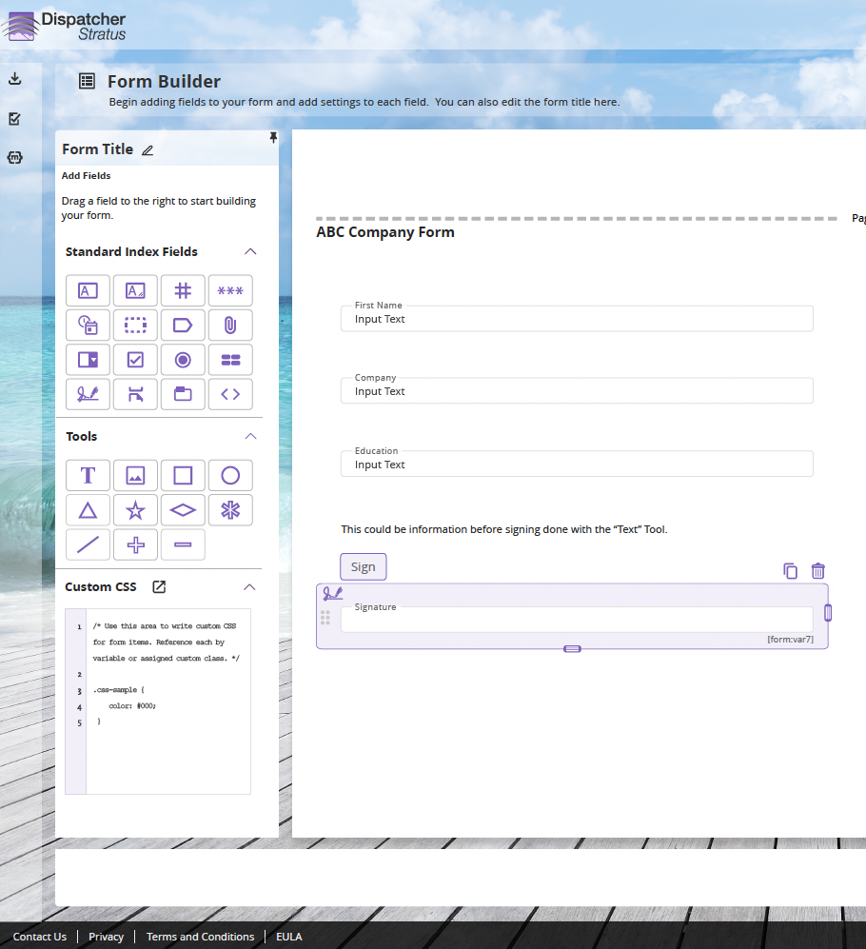
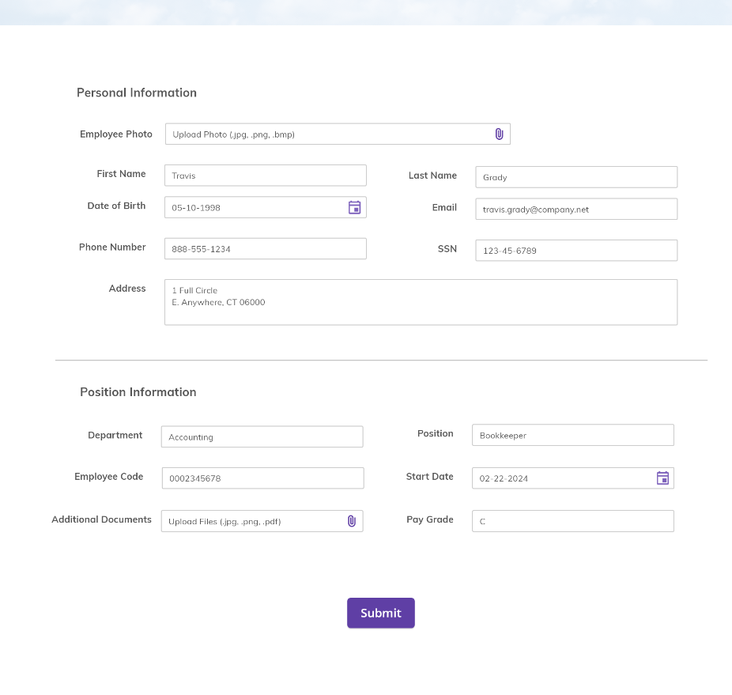








FEATURE HIGHLIGHTS
Form Builder
The Form Builder provides a user-friendly interface for creating customized forms that seamlessly integrate into workflows. Users can easily design forms using a drag-and-drop approach without requiring extensive coding knowledge.
Workflow Builder Tool
This tool allows users to create or edit workflows with an improved graphical interface. It simplifies the process of automating document processing tasks, maximizing efficiency.

Slide 8


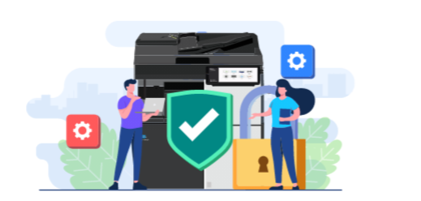
INCLUDED WITH DISPATCHER SCANTRIP CLOUD
Bizhub SECURE Notifier Dashboard
Authentication App
Direct Print

Slide 9

SOLUTION VALUE
Streamline simple to complex workflows:
  People-based tasks
    Basic review/approvals
    Claims Processing
    Invoice Processing
    Purchasing Approval
    Customer/Employee Onboarding
    Remittance Processing
    Etc.
  Electronic form capture
  Intelligent document classification & routing
Moving beyond rigidly defined workflows to smarter workflows.

Slide 10
FEATURE HIGHLIGHTS – ALL THE FEATURES OF DISPATCHER SCANTRIP CLOUD PLUS...
Home Page with Inbox
Access essential notifications and tasks from a centralized inbox-like interface, improving user productivity.
Job Queues & Tracking
Users can view their assigned jobs in curated queues and track job progress throughout the workflow, ensuring timely completion.
MFP Security Monitoring
Integrate with the bizhub SECURE Notifier app to configure MFP security policies and monitor the security of your MFP fleet from anywhere. Receive email reports on demand or whenever a device gets out of sync with its security policy.
MFP Authentication
Built-in MFP authentication allows only users and configured guests to access MFPs – ensure your MFPs are locked down. MFPs can also be configured with public access for high-traffic areas that
require quick scanning access.
People-Based Workflows
Incorporate manual steps within automated workflows for processes that require human intervention, ensuring flexibility and accuracy.
Support for Non-MFP Inputs
Expand workflow capabilities beyond MFPs to include documents from various devices, enhancing flexibility and accessibility.
Advanced Processing & Distribution Nodes
Advanced processing and distribution capabilities can be used to connect to databases, annotate documents, modify metadata, and integrate with third-party applications, expanding workflow functionality.
Portal Customization
Customize the Dispatcher Stratus portal to align with your organization's branding or personalize it according top references.

Slide 11

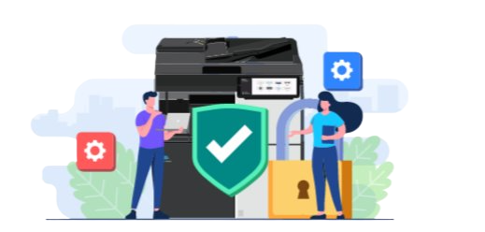


ALSO INCLUDED WITH DISPATCHER STRATUS
Bizhub SECURE Notifier Dashboard
Authentication App
Direct Print
Fleet Monitoring Dashboard

Slide 12
FEATURE COMPARISON
 | ScanTrip Cloud | Starter | Business | Enterprise
Scalable Infrastructure Powered by AWS | ✅ | ✅ | ✅ | ✅
Unlimited Custom Workflow Creation | ✅ | ✅ | ✅ | ✅
Easy Onboarding with Sample Workflows | ✅ | ✅ | ✅ | ✅
Scan Capture form KM MFPs | ✅ | ✅ | ✅ | ✅
Zonal OCR and Document Renaming | ✅ | ✅ | ✅ | ✅
Intelligent Routing | ✅ | ✅ | ✅ | ✅
Direct Connectivity to Cloud Solutions | ✅ | ✅ | ✅ | ✅
Standard Form Management and Document Indexing | ✅ | ✅ | ✅ | ✅
Electronic Document Capture | ❌ | ✅ | ✅ | ✅
User-to-User Job Management | ❌ | ❌ | ✅ | ✅
Customizable Roles & Permissions | ❌ | ❌ | ✅ | ✅
eForm Capture with Optional Authentication | ❌ | ❌ | ✅ | ✅
Real-Time Job & Workflow Notifications | ❌ | ❌ | ✅ | ✅
Additional Connectors to Document Management Solutions | ❌ | ❌ | ✅ | ✅
Advanced Form Management with Stylization and Branding Options | ❌ | ❌ | ❌ | ✅
Advanced eForm Capture with Customizable Authentication | ❌ | ❌ | ❌ | ✅
HTML Embedded Stratus eForms | ❌ | ❌ | ❌ | ✅
Group and Queue Job Management | ❌ | ❌ | ❌ | ✅
Stratus eSignature Workflows | ❌ | ❌ | ❌ | ✅

Slide 13
Licensing

Slide 14
OVERVIEW
Purchase the following components:
Device License - enables the device to connect to the Dispatcher portal and access its features and functionalities.
User Licenses (Optional with Stratus Business and Enterprise only) - enables people-based workflow capabilities.
Release2Me Licenses for Secure Printing (Optional with Any Tier)
Dispatcher ScanTrip Cloud / Dispatcher Stratus App FREE! - must be installed on your MFP. This app connects your device to the Dispatcher Portal.
A tenant is created when you purchase at least one Device license and includes:
Web Portal
MFP Authentication and Cloud SSO
Direct Print
Security Dashboard with bizhub SECURE Notifier
Workflow & Form Builder
User & Device Management
And more!

Slide 15

ANNUAL TERM LICENSING MODEL
Initial Order Components:
Device License(s) for each device or unique capture source
  Valid for both Konica Minolta MFPs and Non-MFP Device Licenses (Stratus only)
  Volume discounts available for 1-9; 10-24; 25-49; 50+
Named User Licenses (Optional, Stratus Business and Enterprise only)
  Enabled people-based workflow capabilities.
Dispatcher ScanTrip Cloud / Stratus MFP Application FREE!
Billing: At the time of order placement, customers will be billed for the entirety of the term. (1, 2, 3, 4, or 5 year options)
Renewals: Term licenses expire after 1-5 years. The customer must place a new (initial) order to continue using the service.
Grace Period for Expired Licenses: If a term license expires without renewal, a 30-day grace period will be granted. Customers will have view-only access to the Dispatcher Stratus portal during this period. Tenant data will be preserved during the grace period, allowing customers to retrieve it before the access is terminated.

Slide 16
ITEM NUMBERS + MSRP
Item # | Device Licenses | MSRP
AEMPA00 | Device License, 1 year (1-9) | $124.00
AEMPA01 | Device License, 2 year (1-9) | $235.60
AEMPA02 | Device License, 3 year (1-9) | $334.80
AEMPA03 | Device License, 4 year (1-9) | $421.60
AEMPA04 | Device License, 5 year (1-9) | $496.00
AEMPA05 | Device License, 1 year (10-49) | $117.80
AEMPA06 | Device License, 2 year (10-49) | $223.82
AEMPA07 | Device License, 3 year (10-49) | $318.06
AEMPA08 | Device License, 4 year (10-49) | $400.52
AEMPA09 | Device License, 5 year (10-49) | $471.20
Item # | Device Licenses | MSRP
AEMPA0A | Device License, 1 year (50-199) | $111.91
AEMPA0C | Device License, 2 year (50-199) | $212.63
AEMPA0D | Device License, 3 year (50-199) | $302.16
AEMPA0E | Device License, 4 year (50-199) | $380.49
AEMPA0F | Device License, 5 year (50-199) | $447.64
AEMPA0G | Device License, 1 year (200+) | $106.31
AEMPA0H | Device License, 2 year (200+) | $202.00
AEMPA0J | Device License, 3 year (200+) | $287.05
AEMPA0K | Device License, 4 year (200+) | $361.47
AEMPA0M | Device License, 5 year (200+) | $425.26
Installation Fees and Pro Services
7640005345 | SEC Consultation Services for DP | $200.00
7640005346 | SEC DEVELOPMENT SERVICES FOR DP | $350.00
7640015792 | DP REMOTE INSTALLATION SERVICES BY SEC | $350.00
$111.91
$212.63
$302.16
$380.49
$447.64
$106.31
$202.00
$287.05
$361.47
$425.26
UPGRADES
AVAILABLE TO ANY DISPATCHER STRATUS TIER!
The Device License Tier is based on the number of unique capture sources that will be enabled in Dispatcher Stratus. Capture sources include Konica Minolta MFPs, Dropbox In folders, etc.

Slide 17
DEVICE LICENSES - STARTER
Item # | Device Licenses | MSRP
AEYAA12 | STARTER, 1 year (1-9) | $241.14
AEYAA13 | STARTER, 2 year (1-9) | $458.17
AEYAA14 | STARTER, 3 year (1-9) | $651.08
AEYAA15 | STARTER, 4 year (1-9) | $819.88
AEYAA16 | STARTER, 5 year (1-9) | $964.56
AEYAA17 | STARTER, 1 year (10-49) | $229.08
AEYAA18 | STARTER, 2 year (10-49) | $435.26
AEYAA19 | STARTER, 3 year (10-49) | $618.52
AEYAA1A | STARTER, 4 year (10-49) | $778.88
AEYAA1C | STARTER, 5 year (10-49) | $916.33
Item # | Device Licenses | MSRP
AEYAA1D | STARTER, 1 year (50-199) | $217.63
AEYAA1E | STARTER, 2 year (50-199) | $413.49
AEYAA1F | STARTER, 3 year (50-199) | $587.60
AEYAA1G | STARTER, 4 year (50-199) | $739.94
AEYAA1H | STARTER, 5 year (50-199) | $870.52
AEYAA1J | STARTER, 1 year (200+) | $206.75
AEYAA1K | STARTER, 2 year (200+) | $392.82
AEYAA1M | STARTER, 3 year (200+) | $558.22
AEYAA1N | STARTER, 4 year (200+) | $702.94
AEYAA1P | STARTER, 5 year (200+) | $826.99
Installation Fees and Pro Services
7640005345 | SEC Consultation Services for DP | $200.00
7640005346 | SEC DEVELOPMENT SERVICES FOR DP | $350.00
7640015792 | DP REMOTE INSTALLATION SERVICES BY SEC | $350.00
UPGRADES
AVAILABLE TO DISPATCHER STRATUS BUSINESS OR ENTERPRISE!
The Device License Tier is based on the number of unique capture sources that will be enabled in Dispatcher Stratus. Capture sources include Konica Minolta MFPs, Dropbox In folders, etc.

Slide 18
DEVICE LICENSES - BUSINESS
Item # | Device Licenses | MSRP
AEYAA1R | BUSINESS, 1 year (1-9) | $479.00
AEYAA1T | BUSINESS, 2 year (1-9) | $910.10
AEYAA1U | BUSINESS, 3 year (1-9) | $1,293.30
AEYAA1V | BUSINESS, 4 year (1-9) | $1,628.60
AEYAA1W | BUSINESS, 5 year (1-9) | $1,916.00
AEYAA1Y | BUSINESS, 1 year (10-49) | $455.05
AEYAA20 | BUSINESS, 2 year (10-49) | $864.60
AEYAA21 | BUSINESS, 3 year (10-49) | $1,228.64
AEYAA22 | BUSINESS, 4 year (10-49) | $1,547.17
AEYAA23 | BUSINESS, 5 year (10-49) | $1,820.20
Item # | Device Licenses | MSRP
AEYAA24 | BUSINESS, 1 year (50-199) | $432.30
AEYAA25 | BUSINESS, 2 year (50-199) | $821.37
AEYAA26 | BUSINESS, 3 year (50-199) | $1,167.20
AEYAA27 | BUSINESS, 4 year (50-199) | $1,469.81
AEYAA28 | BUSINESS, 5 year (50-199) | $1,729.19
AEYAA29 | BUSINESS, 1 year (200+) | $410.68
AEYAA2A | BUSINESS, 2 year (200+) | $780.30
AEYAA2C | BUSINESS, 3 year (200+) | $1,108.84
AEYAA2D | BUSINESS, 4 year (200+) | $1,396.32
AEYAA2E | BUSINESS, 5 year (200+) | $1,642.73
Installation Fees and Pro Services
7640005345 | SEC Consultation Services for DP | $200.00
7640005346 | SEC DEVELOPMENT SERVICES FOR DP | $350.00
7640015792 | DP REMOTE INSTALLATION SERVICES BY SEC | $350.00
UPGRADES
AVAILABLE TO DISPATCHER STRATUS ENTERPRISE!
The Device License Tier is based on the number of unique capture sources that will be enabled in Dispatcher Stratus. Capture sources include Konica Minolta MFPs, Dropbox In folders, etc.

Slide 19
DEVICE LICENSES - ENTERPRISE
Item # | Device Licenses | MSRP
AEYAA00 | ENTERPRISE, 1 year (1-9) | $899.00
AEYAA01 | ENTERPRISE, 2 year (1-9) | $1,708.10
AEYAA02 | ENTERPRISE, 3 year (1-9) | $2,427.30
AEYAA03 | ENTERPRISE, 4 year (1-9) | $3,056.60
AEYAA04 | ENTERPRISE, 5 year (1-9) | $3,596.00
AEYAA05 | ENTERPRISE, 1 year (10-49) | $410.40
AEYAA06 | ENTERPRISE, 2 year (10-49) | $779.76
AEYAA07 | ENTERPRISE, 3 year (10-49) | $1,108.08
AEYAA08 | ENTERPRISE, 4 year (10-49) | $1,395.36
AEYAA09 | ENTERPRISE, 5 year (10-49) | $1,641.60
Item # | Device Licenses | MSRP
AEYAA0A | ENTERPRISE, 1 year (50-199) | $811.35
AEYAA0C | ENTERPRISE, 2 year (50-199) | $1,541.56
AEYAA0D | ENTERPRISE, 3 year (50-199) | $2,190.64
AEYAA0E | ENTERPRISE, 4 year (50-199) | $2,758.58
AEYAA0F | ENTERPRISE, 5 year (50-199) | $3,245.39
AEYAA0G | ENTERPRISE, 1 year (200+) | $770.78
AEYAA0H | ENTERPRISE, 2 year (200+) | $1,464.48
AEYAA0J | ENTERPRISE, 3 year (200+) | $2,081.11
AEYAA0K | ENTERPRISE, 4 year (200+) | $2,620.65
AEYAA0M | ENTERPRISE, 5 year (200+) | $3,083.12
Installation Fees and Pro Services
7640005345 | SEC Consultation Services for DP | $200.00
7640005346 | SEC DEVELOPMENT SERVICES FOR DP | $350.00
7640015792 | DP REMOTE INSTALLATION SERVICES BY SEC | $350.00
The Device License Tier is based on the number of unique capture sources that will be enabled in Dispatcher Stratus. Capture sources include Konica Minolta MFPs, Dropbox In folders, etc.

Slide 20
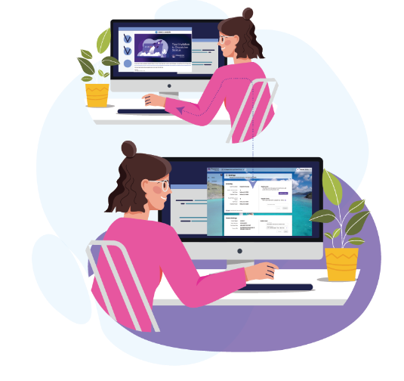
User Licenses
User Licenses are required for unique user that needs to participate in a people-based workflow using one of the following nodes:
People – User
People – Queue
People – Group
People – Edit & Approve
People Queue – Edit & Approve
Collaboration
Survey
Key Details:
User Licenses are available only for the Stratus Business and Enterprise Tiers.
They enable people-based workflow capabilities, facilitating the capture and processing of documents through various devices.
User Licenses are NOT required for general portal users to manage workflows, devices, settings, forms, etc.
Note: The number of User Licenses purchased should align with the number of individuals expected to interact with documents, data, and jobs through the Dispatcher Stratus portal during workflow processing.

Slide 21
USER LICENSES - BUSINESS
Item # | User Licenses | MSRP
AEYAA2F | BUSINESS, 1 year (1-99) | $239.50
AEYAA2G | BUSINESS, 2 year (1-99) | $455.05
AEYAA2H | BUSINESS, 3 year (1-99) | $646.65
AEYAA2J | BUSINESS, 4 year (1-99) | $814.30
AEYAA2K | BUSINESS, 5 year (1-99) | $958.00
AEYAA2M | BUSINESS, 1 year (100-499) | $203.58
AEYAA2N | BUSINESS, 2 year (100-499) | $386.80
AEYAA2P | BUSINESS, 3 year (100-499) | $549.67
AEYAA2R | BUSINESS, 4 year (100-499) | $692.17
AEYAA2T | BUSINESS, 5 year (100-499) | $814.32
Item # | User Licenses | MSRP
AEYAA2U | BUSINESS, 1 year (500-1999) | $173.04
AEYAA2V | BUSINESS, 2 year (500-1999) | $328.78
AEYAA2W | BUSINESS, 3 year (500-1999) | $467.21
AEYAA2Y | BUSINESS, 4 year (500-1999) | $588.34
AEYAA30 | BUSINESS, 5 year (500-1999) | $692.16
AEYAA31 | BUSINESS, 1 year (2000+) | $147.08
AEYAA32 | BUSINESS, 2 year (2000+) | $279.45
AEYAA33 | BUSINESS, 3 year (2000+) | $397.12
AEYAA34 | BUSINESS, 4 year (2000+) | $500.07
AEYAA35 | BUSINESS, 5 year (2000+) | $588.32
Installation Fees and Pro Services
7640005345 | SEC Consultation Services for DP | $200.00
7640005346 | SEC DEVELOPMENT SERVICES FOR DP | $350.00
7640015792 | DP REMOTE INSTALLATION SERVICES BY SEC | $350.00
UPGRADES
AVAILABLE!
The number of User licenses purchased should equal the number of people expected to interact with documents, data, and jobs through the Dispatcher Stratus portal during workflow processing.

Slide 22
USER LICENSES - ENTERPRISE
Item # | User Licenses | MSRP
AEYAA0N | ENTERPRISE, 1 year (1-99) | $449.50
AEYAA0P | ENTERPRISE, 2 year (1-99) | $854.05
AEYAA0R | ENTERPRISE, 3 year (1-99) | $1,213.65
AEYAA0T | ENTERPRISE, 4 year (1-99) | $1,528.30
AEYAA0U | ENTERPRISE, 5 year (1-99) | $1,798.00
AEYAA48 | ENTERPRISE, 1 year (100-499) | $382.08
AEYAA49 | ENTERPRISE, 2 year (100-499) | $725.95
AEYAA4A | ENTERPRISE, 3 year (100-499) | $1,031.62
AEYAA4C | ENTERPRISE, 4 year (100-499) | $1,299.07
AEYAA4D | ENTERPRISE, 5 year (100-499) | $1,528.32
Item # | User Licenses | MSRP
AEYAA4E | ENTERPRISE, 1 year (500-1999) | $324.76
AEYAA4F | ENTERPRISE, 2 year (500-1999) | $617.04
AEYAA4G | ENTERPRISE, 3 year (500-1999) | $876.85
AEYAA4H | ENTERPRISE, 4 year (500-1999) | $1,104.18
AEYAA4J | ENTERPRISE, 5 year (500-1999) | $1,299.04
AEYAA4K | ENTERPRISE,1 year (2000+) | $276.05
AEYAA4M | ENTERPRISE, 2 year (2000+) | $524.50
AEYAA4N | ENTERPRISE, 3 year (2000+) | $745.34
AEYAA4P | ENTERPRISE, 4 year (2000+) | $938.57
AEYAA4R | ENTERPRISE, 5 year (2000+) | $1,104.20
Installation Fees and Pro Services
7640005345 | SEC Consultation Services for DP | $200.00
7640005346 | SEC DEVELOPMENT SERVICES FOR DP | $350.00
7640015792 | DP REMOTE INSTALLATION SERVICES BY SEC | $350.00
The number of User licenses purchased should equal the number of people expected to interact with documents, data, and jobs through the Dispatcher Stratus portal during workflow processing.

Slide 23


Slide 24


SECURE PRINT RELEASE IN THE CLOUD
Make Document Security a Priority
Release2Me allows admins to configure queues that temporarily store documents for printing, which can be quickly released at the MFP. No more grabbing the wrong document, accidentally throwing away someone's print job, or documents being stolen from the printer.
Environmentally Friendly
Extend the lifespan of your MFP fleet by only printing the documents you need. Save on paper and other printing costs as well.
Highly Customizable
Print queues can be configured with specific print settings to ensure every job is printed correctly the first time.

Slide 25

FEATURE HIGHLIGHTS
Personal Print Queue
Users automatically get a secure, personal print queue. They can upload documents to it directly or configure a computer with a print queue just like a printer. Users can even delegate jobs to other users.
Shared Print Queues
Admins can create shared queues, where any queue member can access shared documents. This is perfect for common documents like order forms, work requests, etc.
Guest Print Queues
Temporary users who need print access can be added to guest queues. These offer temporary access to MFPs with a simple login. Use guest queue for visiting employees, conference attendees, job candidates, and more!
Secure Print Release at the MFP
Users can quickly log in at the MFP and see all jobs available in all their queues. They can select the print job or jobs they would like to print, and the MFP will print those jobs. Jobs can even be saved for the future in case they need to be printed multiple times.

Slide 26
ITEM NUMBERS + MSRP
Item # | Device Licenses | MSRP
AEYAA4T | R2Me License, 1 year (1-9) | $124.00
AEYAA4U | R2Me License, 2 year (1-9) | $124.00
AEYAA4V | R2Me License, 3 year (1-9) | $124.00
AEYAA4W | R2Me License, 4 year (1-9) | $124.00
AEYAA4Y | R2Me License, 5 year (1-9) | $124.00
AEYAA50 | R2Me License, 1 year (10-49) | $117.80
AEYAA51 | R2Me License, 2 year (10-49) | $117.80
AEYAA52 | R2Me License, 3 year (10-49) | $117.80
AEYAA53 | R2Me License, 4 year (10-49) | $117.80
AEYAA54 | R2Me License, 5 year (10-49) | $117.80
Item # | Device Licenses | MSRP
AEYAA55 | R2Me License, 1 year (50-199) | $111.91
AEYAA56 | R2Me License, 2 year (50-199) | $111.91
AEYAA57 | R2Me License, 3 year (50-199) | $111.91
AEYAA58 | R2Me License, 4 year (50-199) | $111.91
AEYAA59 | R2Me License, 5 year (50-199) | $111.91
AEYAA5A | R2Me License, 1 year (200+) | $106.31
AEYAA5C | R2Me License, 2 year (200+) | $106.31
AEYAA5D | R2Me License, 3 year (200+) | $106.31
AEYAA5E | R2Me License, 4 year (200+) | $106.31
AEYAA5F | R2Me License, 5 year (200+) | $106.31
Installation Fees and Pro Services
7640005345 | SEC Consultation Services for DP | $200.00
7640005346 | SEC DEVELOPMENT SERVICES FOR DP | $350.00
7640015792 | DP REMOTE INSTALLATION SERVICES BY SEC | $350.00
UPGRADES
AVAILABE!

Slide 27
Ordering

Slide 28

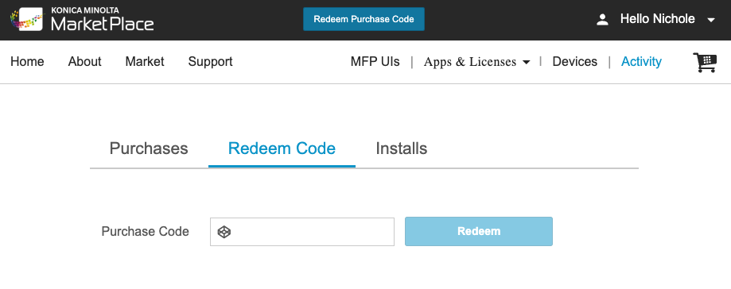
ORDERING
Place order via Enterprise Resource Planning (ERP) system, such as SAP.
Purchase Confirmation via Email
After placing an order, MarketPlace sends the customer a purchase code via email that can be redeemed within the MarketPlace.
NOTE: Term customers pay upfront for their plan, no refunds will be issued for changes, including removing purchased device licenses or canceling the plan.

Slide 29
ORDERING REQUIREMENTS
ALL ORDERS FOR NEW CUSTOMERS MUST INCLUDE:
At least one (1) device license to activate the tenant and power document capture workflows
The same term for all licenses in the order
  New tenant cannot support mixed term licenses!
SAMPLE ORDER FOR A NEW TENANT
ALL ORDERS FOR EXISTING CUSTOMERS MUST INCLUDE:
Additional Device or user licenses, as needed to power a customers workflows
Can support mixed terms to extend the time of service
Can support only licenses for add-ins
SAMPLE ORDER FOR AN EXISTING TENANT
Item # | Item Description | QTY
AEMPA01 | Device License, 2 year (1-9) | 3
AEYAA4U | R2Me License, 2 year (1-9) | 3
Item # | Item Description | QTY
AEMPA01 | Device License, 2 year (1-9) | 3
AEYAA4V | R2Me License, 3 year (1-9) | 3
This order will support scanning with ScanTrip Cloud and printing with Release2Me Cloud on 3 devices for 2 years.
This order will support scanning with ScanTrip Cloud for 3 devices and a total of 2 years. Additionally, this customer is adding printing with Release2Me Cloud on 3 devices for 2 years.
Assuming the customer has 1 year of scanning left on their existing tenant, the scan and print licenses will be co-termed.

Slide 30

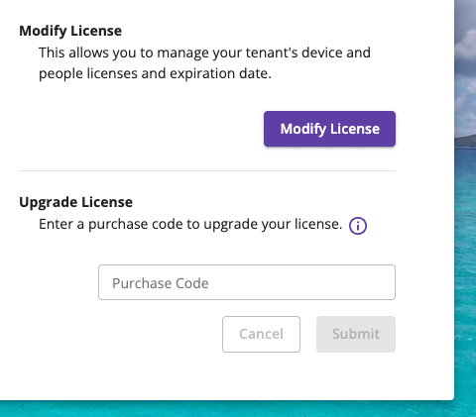
ORDERING DEVICE LICENSES - EXAMPLE
EXAMPLE 1: A small office has 3 devices and wants to try out scan workflows for 2 years.
A sales representative places an order for the following items:
EXAMPLE 1.1: Six months later, the same small office enjoyed the service and wants to add 5 additional devices to their current instance/tenant for 2 years.
A sales representative places an
order for the following items:
Item # | Item Description | QTY
AEMPA01 | Device License, 2 year (1-9) | 3
Item # | Item Description | QTY
AEMPA01 | Device License, 2 year (1-9) | 5
Upon the redemption of the purchase code, the customer will be given the option to extend the term of their existing device licenses or to add additional device licenses.
When adding additional devices, the time of service remaining on the existing devices, plus the total purchased, will be averaged across all devices to determine the new expiration date.
NOTE: Purchase codes to upgrade an existing tenant must be redeemed in the tenant and NOT using Konica Minolta MarketPlace.

Slide 31

ORDERING DEVICE + USER LICENSES - EXAMPLE
EXAMPLE 2: A medium-sized office with 50 devices would like to introduce a scan workflow for all devices and set up document collection from 5 emails and 5 fax accounts. In addition, 10 users will need to interact with documents for approval during a workflow.
With Dispatcher Stratus, this request can be efficiently automated with the correct setup.
A sales representative should place an order with the following items:
EXAMPLE 2.2: Six months later, the same medium-sized office enjoyed the service
and wants to add 10 additional users to their current instance/tenant for 1 year.
A sales representative places an order for the following items:
Item # | Item Description | QTY
AEYAA24 | BUSINESS, 1 year (50-199) | 60
AEYAA2F | BUSINESS, 1 year (1-99) | 10
Item # | Item Description | QTY
AEYAA2F | BUSINESS, 1 year (1-99) | 10
The number of User licenses purchased should equal the number of people expected to interact with documents, data, and jobs through the Dispatcher Stratus portal during workflow processing.
The License Tier is based on the number of unique capture sources or users that will be enabled in Dispatcher Stratus.

Slide 32
LICENSING FAQs
Does Dispatcher Stratus Support Multi-Year Term Licenses?
Yes! Please refer to the Item Numbers page for all of the available options.
Is There A Minimum Requirement For Dispatcher Stratus Orders? No. Each term license order of Dispatcher Stratus includes access to the Dispatcher Stratus portal and access to Dispatcher Stratus at one device.
What Happens When A Dispatcher Stratus License Expires?
Dispatcher Stratus Term licenses cease to function after the license expires (1-5 years). However, a grace period is provided allowing view-only access to the tenant.
What If A Customer Already Has A Dispatcher Stratus Term License And Wants To Add Devices To It?
Customers can purchase additional device licenses to expand an existing tenant. Using the Settings page in the Dispatcher Stratus portal, a tenant admin can redeem additional purchase codes to add devices to their current tenant.
What Happens If A Customer Wants To Downgrade Or Cancel Their Plan? As term customers pay upfront for their plan, no refunds will be issued for changes to their plan. This includes scenarios such as removing purchased device licenses or canceling the plan.
Can Licenses Be Transferred Between Devices Or Users? Yes. Licenses can be transferred between devices or users, but sharing user accounts is prohibited.
Should Sales Prepare A BNA (Business Needs Assessment)? Yes. A BNA is required for SEC to quote professional services for any implementation that requires remote installation services or custom workflow configurations.

Slide 33





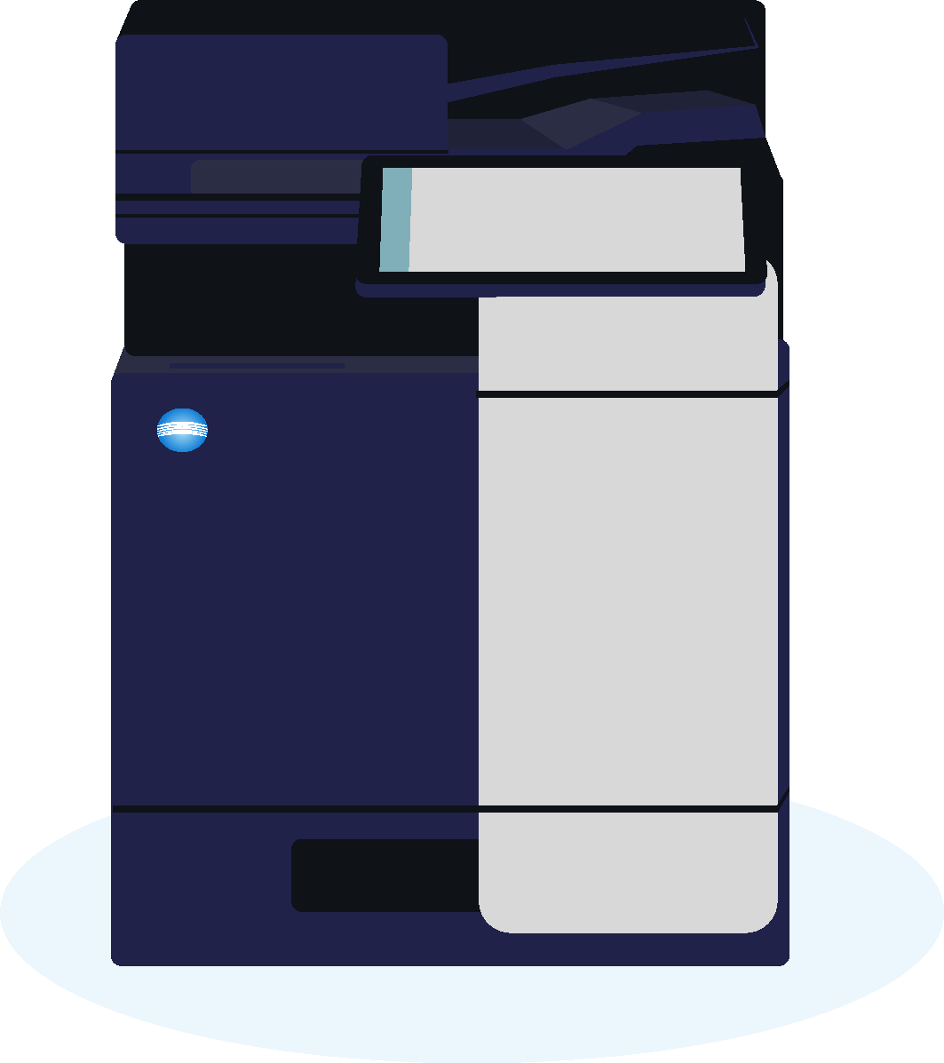

DISPATCHER
Stratus
Automating admin tasks and
workflows that involve human input.
NFR LICENSE
NFR licenses are available for Sales Rep use.
Click link to request sec.kmbs.us
CUSTOMER OPPORTUNITY?
OFFER THEM A FREE TRIAL!
To help our customers get started, offer them a 15-days free with 3 capture licenses and 3 print licenses. Daily processing limitation apply.
Request a Trial license here:
DispatcherStratus.com
Comprehensive help for Dispatcher Stratus help.DispatcherStratus.com
Contact For Pricing
(annual term)
Designed for businesses who want to enhance processes across the entire organization. Adding to the proven Dispatcher family of document workflows solutions with people-based workflows to open up a whole new range of tasks that can be optimized.
Learn
MORE!
DISPATCHER
ScanTrip Cloud
Cloud Based Document
Scanning Management
Contact For Pricing
(annual term)
Ideal for businesses with a focus on optimizing their simple document process workflows.
Learn
MORE!

